Slide 1


Principles of Information Security
Sixth Edition
Chapter 4
Planning for Security
Copyright © 2018 Cengage. May not be copied, scanned, or duplicated, in whole or in part, except for use as permitted in a license distributed with a certain product or service or otherwise on a password-protected website for classroom use.

Slide 2
Learning Objectives (1 of 2)
Upon completion of this material, you should be able to:
Describe management’s role in the development, maintenance, and enforcement of information security policy, standards, practices, procedures, and guidelines
Explain what an information security blueprint is, identify its major components, and explain how it supports the information security program
Notes:
Learning Objectives
Upon completion of this material, you should be able to:
Describe management’s role in the development, maintenance, and enforcement of information security policy, standards, practices, procedures, and guidelines
Explain what an information security blueprint is, identify its major components, and explain how it supports the information security program

Slide 3
Learning Objectives (2 of 2)
Discuss how an organization institutionalizes its policies, standards, and practices using education, training, and awareness programs
Describe what contingency planning is and how it relates to incident response planning, disaster recovery planning, and business continuity plans
Notes:
Learning Objectives
Upon completion of this material, you should be able to:
Describe management’s role in the development, maintenance, and enforcement of information security policy, standards, practices, procedures, and guidelines
Explain what an information security blueprint is, identify its major components, and explain how it supports the information security program

Slide 4
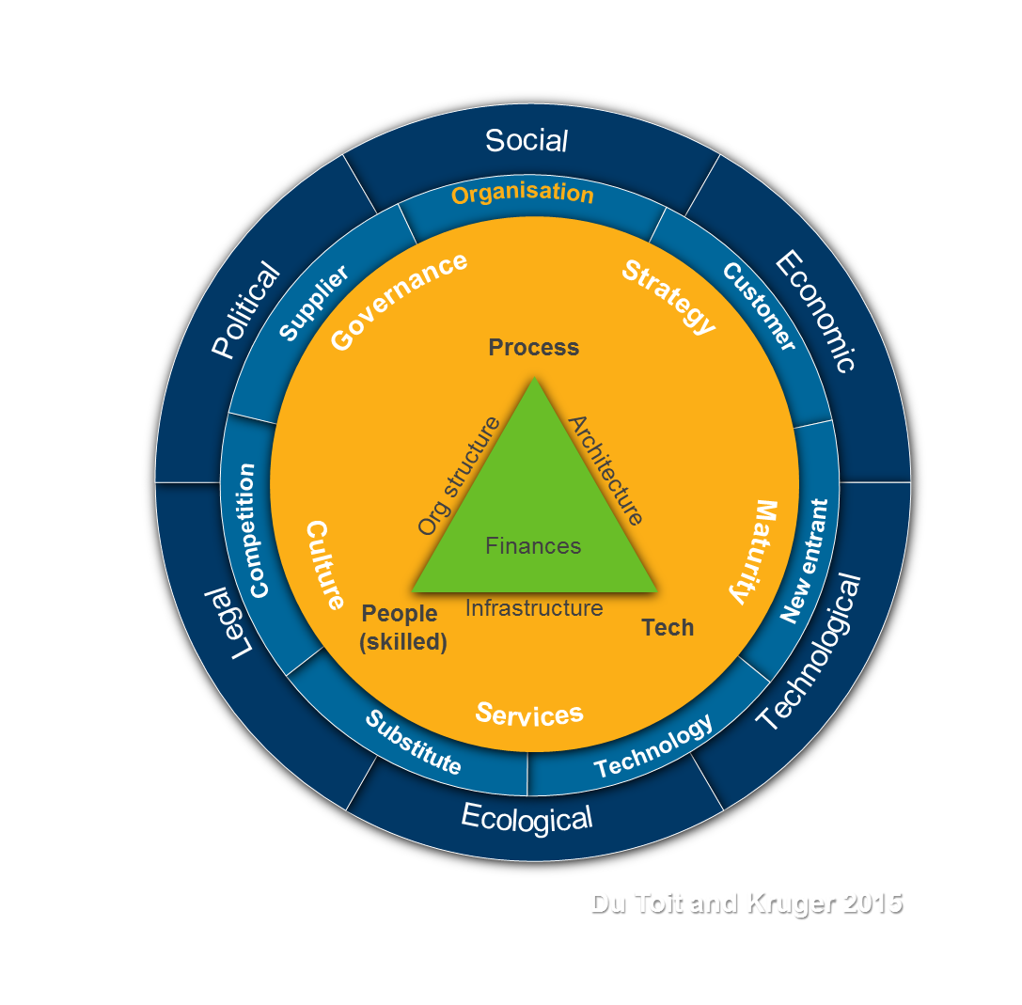
Introduction
Information security program begins with (Governance) policies, standards, and (Process) practices which are the foundation for information security architecture and blueprint.
Coordinated planning is required to create and maintain these elements.
Strategic planning for the management of allocation of resources.
Contingency planning for the preparation of uncertain business environment.
Notes:
Introduction
Information security program begins with policies, standards, and practices, which are the foundation for information security architecture and blueprint
Coordinated planning required to create and maintain these elements
Strategic planning for management of allocation of resources
Contingency planning for preparation of uncertain business environment

Slide 5
Information Security Planning and Governance (1 of 2)
Planning levels help translate organization’s strategic plans into tactical objectives
Planning and the CISO
Information security governance
Governance:
Set of responsibilities and practices exercised by the board and executive management
Goal to provide strategic direction, establishment of objectives, and measurement of progress toward objectives
Also verifies/validates that risk management practices are appropriate and assets used properly
Notes:
InfoSec Planning and Governance
Planning levels help translate organization’s strategic plans into tactical objectives
Planning and the CISO
Information Security Governance
Governance:
Set of responsibilities and practices exercised by the board and executive management
Goal to provide strategic direction, establishment of objectives, and measurement of progress toward objectives
Also verifies/validates that risk management practices are appropriate and assets used properly

Slide 6
Information Security Planning and Governance (2 of 2)
Information security governance outcomes
Five goals:
Strategic alignment
Resource management
Performance measurement
Value delivery
Risk management
Notes:
InfoSec Planning and Governance
Information Security Governance outcomes
Five goals
Strategic alignment
Risk management
Resource management
Performance measures
Value delivery

Slide 7
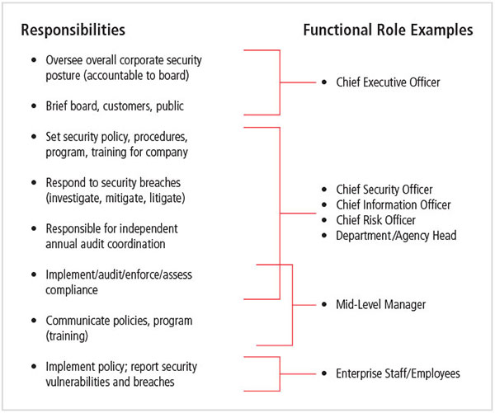
Figure 4-1 Information security governance roles and responsibilities
Source: This information is derived from the Corporate Governance Task Force Report, “Information Security Governance: A Call to Action,” April 2004, National Cyber Security Task Force.

Slide 8
Information Security Policy, Standards, and Practices
Management from communities of interest must make policies the basis for all information security planning, design, and deployment.
Policies direct how issues should be addressed and technologies used.
Policies should never contradict law, must be able to stand up in court, and must be properly administered.
Security policies are the least expensive controls to execute but most difficult to implement properly.
Notes:
Information Security Policy, Standards, and Practices
Management from communities of interest must make policies the basis for all information security planning, design, and deployment
Policies direct how issues should be addressed and technologies used
Policies should never contradict law, must be able to stand up in court, must be properly administered
Security policies are the least expensive controls to execute but most difficult to implement properly

Slide 9
Policy as the Foundation for Planning
Policy functions as organizational law that dictates acceptable and unacceptable behavior.
Standards: more detailed statements of what must be done to comply with policy.
Practices, procedures, and guidelines effectively explain how to comply with policy (Frameworks).
For a policy to be effective, it must be properly disseminated, read, understood, and agreed to by all members of the organization, and uniformly enforced.
Notes:
Policy as Foundation for Planning
Policy functions as organizational law that dictates acceptable and unacceptable behavior
Standards: more detailed statements of what must be done to comply with policy
Practices, procedures, and guidelines effectively explain how to comply with policy
For a policy to be effective, it must be properly disseminated, read, understood, and agreed to by all members of organization, and uniformly enforced

Slide 10
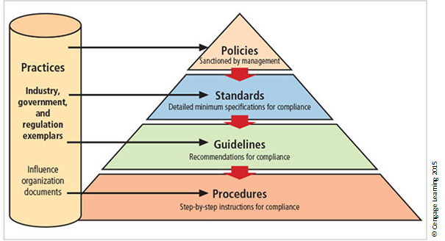
Figure 4-2 Policies, standards, guidelines, and procedures
Notes:
Types of Policy
Management defines three types of security policy:
1) General or security program policy
2) Issue-specific security policies
3) Systems-specific security policies

Slide 11
Enterprise Information Security Policy (EISP) (1 of 2)
Sets strategic direction, scope, and tone for all security efforts within the organization
Executive-level document, usually drafted by or with chief information officer (CIO) of the organization
Typically addresses compliance in two areas:
General compliance to ensure meeting of requirements to establish program and assigning responsibilities therein to various organizational components
Use of specified penalties and disciplinary action
Notes:
Enterprise Information Security Policy (EISP)
Sets strategic direction, scope, and tone for all security efforts within the organization
Executive-level document, usually drafted by or with Chief Information Officer (CIO) of the organization
Typically addresses compliance in two areas
Ensure meeting of requirements to establish program and assigning responsibilities therein to various organizational components
Use of specified penalties and disciplinary action

Slide 12
Enterprise Information Security Policy (EISP) (2 of 2)
EISP Elements should include:
Overview of the corporate security philosophy
Information on the structure of the organization and people in information security roles
Articulated responsibilities for security shared by all members of the organization
Articulated responsibilities for security unique to each role in the organization
Notes:
Enterprise Information Security Policy (EISP)
EISP Elements should include
Overview of corporate security philosophy
Information on structure of organization and people in information security roles
Articulated responsibilities for security shared by all members of organization
Articulated responsibilities for security unique to each role in organization

Slide 13
Table 4-1 Components of the EISP (1 of 3)
Component | Description
Statement of Purpose | Answers the question 'What is this policy for?" Provides a framework that helps the reader understand the intent of the document. Can include text such as the following: This document will: Identify the elements of a good security policy Explain the need for information security Specify the various categories of information security Identify the information security responsibilities and roles Identify appropriate levels of security through standards and guidelines This document establishes an overarching security policy and direction for our company. Individual departments are expected to establish standards, guidelines, and operating procedures that adhere to and reference this policy while addressing their specific and individual needs."

Slide 14
Table 4-1 Components of the EISP (2 of 3)
Component | Description
Information Security Elements | Defines information security. For example: "Protecting the confidentiality, integrity, and availability of information while in processing, transmission, and storage, through the use of policy, education and training, and technology ..." This section can also lay out security definitions or philosophies to clarify the policy.
Need for Information Security | Provides information on the importance of information security in the organization and the legal and ethical obligation to protect critical information about customers, employees, and markets.

Slide 15
Table 4-1 Components of the EISP (3 of 3)
Component | Description
Information Security Responsibilities and Roles | Defines the organizational structure designed to support information security within the organization. Identifies categories of people with responsibility for information security (IT department, management, users) and those responsibilities, including maintenance of this document.
Reference Standards to Other Information and Guidelines | Lists other standards that influence this policy document and are influenced by it, perhaps including relevant federal laws, state laws, and other policies.

Slide 16
Issue-Specific Security Policy (ISSP) (1 of 2)
The ISSP:
Addresses specific areas of technology
Requires frequent updates
Contains statement on the organization’s position on specific issue
Three common approaches when creating and managing ISSPs:
Create a number of independent ISSP documents
Create a single comprehensive ISSP document
Create a modular ISSP document
Notes:
Issue-Specific Security Policy (ISSP)
The ISSP:
Addresses specific areas of technology
Requires frequent updates
Contains statement on organization’s position on specific issue
Three common approaches when creating and managing ISSPs:
Create a number of independent ISSP documents
Create a single comprehensive ISSP document
Create a modular ISSP document

Slide 17
Issue-Specific Security Policy (ISSP) (2 of 2)
Components of the policy:
Statement of policy
Authorized access and usage of equipment
Prohibited use of equipment
Systems management
Violations of policy
Policy review and modification
Limitations of liability
Example: Information Policy
Notes:
ISSP cont’d.
Components of the policy
Statement of Policy
Authorized Access and Usage of Equipment
Prohibited Use of Equipment
Systems Management
Violations of Policy
Policy Review and Modification
Limitations of Liability

Slide 18
Table 4-2 Components of the ISSP (1 of 4)
Statement of policy
Scope and applicability
Definition of technology addressed
Responsibilities
Authorized access and usage of equipment
User access
Fair and responsible use
Protection of privacy
Notes:
Source: Whitman, Townsend, and Aalberts, Communication of the ACM.

Slide 19
Table 4-2 Components of the ISSP (2 of 4)
Prohibited use of equipment
Disruptive use or misuse
Criminal use
Offensive or harassing materials
Copyrighted, licensed, or other intellectual property
Other restrictions
Systems management
Management of stored materials
Employee monitoring
Virus protection
Notes:
Source: Whitman, Townsend, and Aalberts, Communication of the ACM.

Slide 20
Table 4-2 Components of the ISSP (3 of 4)
Physical security
Encryption
Violations of policy
Procedures for reporting violations
Penalties for violations
Policy review and modification
Scheduled review of policy procedures for modification
Legal disclaimers
Notes:
Source: Whitman, Townsend, and Aalberts, Communication of the ACM.

Slide 21
Table 4-2 Components of the ISSP (4 of 4)
Limitations of liability
Statements of liability
Other disclaimers as needed
Notes:
Source: Whitman, Townsend, and Aalberts, Communication of the ACM.

Slide 22
Systems-Specific Security Policy (SysSP) (1 of 2)
SysSPs often function as standards or procedures used when configuring or maintaining systems.
SysSPs fall into two groups:
Managerial guidance
Technical specifications
Access control lists (ACLs) can restrict access for a particular user, computer, time, duration—even a particular file.
Notes:
Systems-Specific Policy (SysSP)
SysSPs often function as standards or procedures used when configuring or maintaining systems
Systems-specific policies fall into two groups
Managerial guidance
Technical specifications
Access control lists (ACLs) can restrict access for a particular user, computer, time, duration—even a particular file
Configuration rule policies govern how security system reacts to received data
Combination SysSPs combine managerial guidance and technical specifications

Slide 23
Systems-Specific Security Policy(SysSP) (2 of 2)
Configuration rule policies govern how a security system reacts to received data.
Combination SysSPs combine managerial guidance and technical specifications.
Notes:
Systems-Specific Policy (SysSP)
SysSPs often function as standards or procedures used when configuring or maintaining systems
Systems-specific policies fall into two groups
Managerial guidance
Technical specifications
Access control lists (ACLs) can restrict access for a particular user, computer, time, duration—even a particular file
Configuration rule policies govern how security system reacts to received data
Combination SysSPs combine managerial guidance and technical specifications

Slide 24
Policy Management
Policies must be managed as they constantly change.
To remain viable, security policies must have:
A responsible manager
A schedule of reviews
A method for making recommendations for reviews
A policy issuance and revision date
Automated policy management
Notes:
Policy Management
Policies must be managed as they constantly change
To remain viable, security policies must have:
Responsible manager
A schedule of reviews
Method for making recommendations for reviews
Policy issuance and revision date
Automated policy management

Slide 25
The Information Security Blueprint
Basis for design, selection, and implementation of all security policies, education and training programs, and technological controls
Detailed version of security framework (outline of overall information security strategy for organization)
Specifies tasks and order in which they are to be accomplished
Should also serve as a scalable, upgradeable, and comprehensive plan for the current and future information security needs
(Base/ Best Practice - Frameworks)
Notes:
Information Security Blueprints
Basis for design, selection, and implementation of all security policies, education and training programs, and technological controls
Detailed version of security framework (outline of overall information security strategy for organization)
Specifies tasks and order in which they are to be accomplished
Should also serve as scalable, upgradeable, and comprehensive plan for current and future information security needs

Slide 26
The ISO 27000 Series (1 of 8)
One of the most widely referenced security models
Standard framework for information security that states organizational security policy is needed to provide management direction and support
Purpose is to give recommendations for information security management
Provides a starting point for developing organizational security
Notes:
ISO 17799/BS 7799
One of the most widely referenced security models
Standard framework for information security that states organizational security policy is needed to provide management direction and support
Purpose is to give recommendations for information security management
Provides a starting point for developing organizational security

Slide 27
The ISO 27000 Series (2 of 8)
ISO/IEC 27000—Information security management systems; overview and vocabulary
ISO/IEC 27001—Information technology; security techniques; information security management systems
ISO/IEC 27002—Code of practice for information security management
ISO/IEC 27003—Information security management system implementation guidance

Slide 28
The ISO 27000 Series (3 of 8)
ISO/IEC 27004—Information security management; measurement
ISO/IEC 27005—Information security risk management
ISO/IEC 27006—Requirements for bodies providing audit and certification of information security management systems
ISO/IEC 27007—Guidelines for information security management systems auditing (focused on the management system)

Slide 29
The ISO 27000 Series (4 of 8)
ISO/IEC TR 27008—Guidance for auditors on ISMS controls (focused on the information security controls)
ISO/IEC 27010—Information security management for inter-sector and inter-organizational communications
ISO/IEC 27011—Information security management guidelines for telecommunications organizations based on ISO/IEC 27002

Slide 30
The ISO 27000 Series (5 of 8)
ISO/IEC 27013—Guidance on the integrated implementation of ISO/IEC 27001 and ISO/IEC 20000-1
ISO/IEC 27014—Information security governance.
ISO/IEC TR 27015—Information security management guidelines for financial services
ISO/IEC 27017—Code of practice for information security controls based on ISO/IEC 27002 for cloud services

Slide 31
The ISO 27000 Series (6 of 8)
ISO/IEC 27018—Code of practice for protection of personally identifiable information (PII) in public clouds acting as PII processors
ISO/IEC 27031—Guidelines for information and communication technology readiness for business continuity
ISO/IEC 27032—Guideline for cybersecurity
ISO/IEC 27033-1—Network security—Part 1: Overview and concepts

Slide 32
The ISO 27000 Series (7 of 8)
ISO/IEC 27033-2—Network security—Part 2: Guidelines for the design and implementation of network security
ISO/IEC 27033-3—Network security—Part 3: Reference networking scenarios; threats, design techniques and control issues
ISO/IEC 27033-5—Network security—Part 5: Securing communications across networks using Virtual Private Networks (VPNs)

Slide 33
The ISO 27000 Series (8 of 8)
ISO/IEC 27034-1—Application security—Part 1: Guideline for application security
ISO/IEC 27035—Information security incident management
ISO/IEC 27036-3—Information security for supplier relationships—Part 3: Guidelines for information and communication technology supply chain security
ISO/IEC 27037—Guidelines for identification, collection, acquisition and preservation of digital evidence
ISO 27799—Information security management in health using ISO/IEC 27002

Slide 34
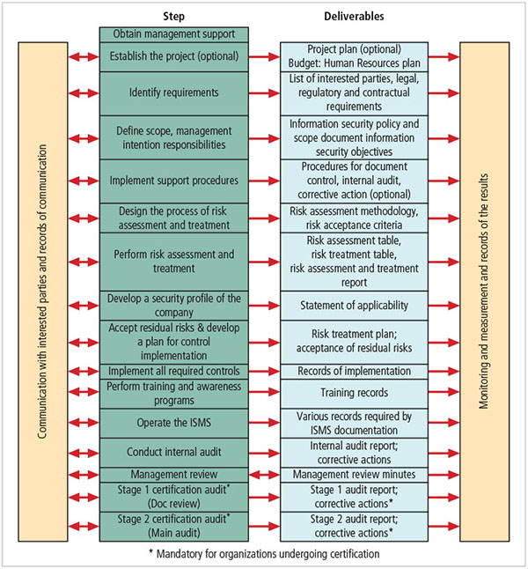
Figure 4-7 ISO/IEC 27001:2013 major process steps
Source: 27001 Academy: ISO 27001 and ISO 22301 Online Consultation Center

Slide 35
NIST Security Models
Another possible approach described in the documents available from Computer Security Resource Center of NIST
SP 800-12
SP 800-14
SP 800-18 Rev. 1
SP 800-26
SP 800-30
Notes:
NIST Security Models
Another approach available is described in the many documents available from the Computer Security Resource Center of the National Institute for Standards and Technology (csrc.nist.gov).
These are among the references cited by the government of the U.S. when deciding not to select the ISO/IEC 17799 standards.
NIST SP 800-12 - The Computer Security Handbook is an excellent reference and guide for the security manager or administrator in the routine management of information security.
NIST SP 800-14 - Generally Accepted Principles and Practices for Securing IT Systems provides best practices and security principles that can direct the development of a security blueprint.
NIST SP 800-18 - The Guide for Developing Security Plans for IT Systems is considered the foundation for a comprehensive security blueprint and framework. It provides detailed methods for assessing, designing, and implementing controls and plans for various sized applications.

Slide 36
NIST Special Publication 800-14 (1 of 2)
Security supports the mission of the organization and is an integral element of sound management.
Security should be cost effective; owners have security responsibilities outside their own organizations.
Security responsibilities and accountability should be made explicit; security requires a comprehensive and integrated approach.
Notes:
NIST SP 800-14 Generally Accepted Principles and Practices
Security supports mission of organization; is an integral element of sound management
Security should be cost effective; owners have security responsibilities outside their own organizations
Security responsibilities and accountability should be made explicit; security requires a comprehensive and integrated approach
Security should be periodically reassessed; security is constrained by societal factors
33 principles for securing systems (see Table 4-5)

Slide 37
NIST Special Publication 800-14 (2 of 2)
Security should be periodically reassessed; security is constrained by societal factors.
Thirty-three principles for securing systems (see Table 4-5).
Notes:
NIST SP 800-14 Generally Accepted Principles and Practices
Security supports mission of organization; is an integral element of sound management
Security should be cost effective; owners have security responsibilities outside their own organizations
Security responsibilities and accountability should be made explicit; security requires a comprehensive and integrated approach
Security should be periodically reassessed; security is constrained by societal factors
33 principles for securing systems (see Table 4-5)

Slide 38
NIST Cybersecurity Framework (1 of 2)
Consists of three fundamental components:
Framework core: set of information security activities an organization is expected to perform and their desired results
Framework tiers: help relate the maturity of security programs and implement corresponding measures and functions
Framework profile: used to perform a gap analysis between the current and a desired state of information security/risk management
Notes:
NIST Cybersecurity Framework
Consists of three fundamental components
Framework core: set of information security activities organization is expected to perform and desired results
Framework tiers: help relate maturity of security programs and implement corresponding measures and functions
Framework profile: used to perform gap analysis between current and desired state of information security/risk management

Slide 39
NIST Cybersecurity Framework (2 of 2)
Seven-step approach to implementing/improving programs:
Prioritize and scope
Orient
Create current profile
Conduct risk assessment
Create target profile
Determine, analyze, and prioritize gaps
Implement action plan
Notes:
NIST Cybersecurity Framework
Seven-step approach to implementing/improving programs:
Prioritize and scope
Orient
Create current profile
Conduct risk assessment
Create target profile
Determine, analyze, prioritize gaps
Implement action plan

Slide 40
Other Sources of Security Frameworks
Computer Emergency Response Team Coordination Center (CERT/CC)
International Association of Professional Security Consultants
Notes:
Other Sources of Security Frameworks
Federal Agency Security Practices (FASP)
Computer Emergency Response Team Coordination Center (CERT/CC)
International Association of Professional Security Consultants

Slide 41
Design of Security Architecture (1 of 2)
Spheres of security: foundation of the security framework
Levels of controls:
Management controls set the direction and scope of the security processes and provide detailed instructions for its conduct.
Operational controls address personnel and physical security and the protection of production inputs/outputs.
Technical controls are the tactical and technical implementations related to designing and integrating security in the organization.
Notes:
Design of Security Architecture
Spheres of security: foundation of the security framework
Levels of controls
Management controls set direction and scope of security processes, provide detailed instructions for its conduct
Operational controls address personnel and physical security, and protection of production inputs/outputs
Technical controls are tactical and technical implementations related to designing and integrating security in organization

Slide 42
Design of Security Architecture (2 of 2)
Defense in depth
Implementation of security in layers
Requires that organization establish multiple layers of security controls and safeguards
Security perimeter
Border of security protecting internal systems from outside threats
Does not protect against internal attacks from employee threats or onsite physical threats
Notes:
The Design of Security Architecture
Defense in Depth – One of the foundations of security architectures is the requirement to implement security in layers. Defense in depth requires that the organization establish sufficient security controls and safeguards, so that an intruder faces multiple layers of controls.
Security Perimeter – The point at which an organization’s security protection ends and the outside world begins is referred to as the security perimeter. Unfortunately, the perimeter does not apply to internal attacks from employee threats or on-site physical threats.

Slide 43
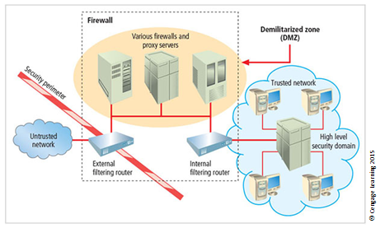
Figure 4-10 Security perimeters and domains

Slide 44
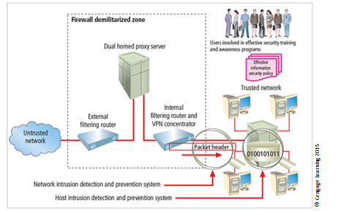
Figure 4-9 Defense in depth

Slide 45
Security Education, Training, and Awareness Program
Once general security policy exists, implement security education, training, and awareness (SETA) program.
SETA is a control measure designed to reduce accidental security breaches.
The SETA program consists of security education, security training, and security awareness.
It enhances security by improving awareness, developing skills and knowledge, and building in-depth knowledge.
Notes:
Security Education, Training, and Awareness Program
Once general security policy exists, implement security education, training, and awareness (SETA) program
SETA is a control measure designed to reduce accidental security breaches
The SETA program consists of: security education; security training; and security awareness
Enhances security by improving awareness, developing skills and knowledge, and building in-depth knowledge

Slide 46
Security Education
Everyone in an organization needs to be trained and aware of information security; not every member needs a formal degree or certificate in information security.
When formal education is deemed appropriate, an employee can investigate courses in continuing education from local institutions of higher learning.
A number of universities have formal coursework in information security.
Notes:
Security Education
Everyone in an organization needs to be trained and aware of information security; not every member needs formal degree or certificate in information security
When formal education is deemed appropriate, an employee can investigate courses in continuing education from local institutions of higher learning
A number of universities have formal coursework in information security

Slide 47
Security Training
Provides members of the organization with detailed information and hands-on instruction to prepare them to perform their duties securely.
Management of information security can develop customized in-house training or outsource the training program.
Alternatives to formal training include conferences and programs offered through professional organizations.
Notes:
Security Training
Provides members of organization with detailed information and hands-on instruction to prepare them to perform their duties securely
Management of information security can develop customized in-house training or outsource the training program
Alternatives to formal training include conferences and programs offered through professional organizations

Slide 48
Security Awareness
One of the least frequently implemented but most beneficial programs is the security awareness program.
It is designed to keep information security at the forefront of users’ minds.
It need not be complicated or expensive.
If the program is not actively implemented, employees may begin to neglect security matters, and risk of employee accidents and failures is likely to increase.
Notes:
Security Awareness
One of least frequently implemented but most beneficial programs is the security awareness program
Designed to keep information security at the forefront of users’ minds
Need not be complicated or expensive
If the program is not actively implemented, employees may begin to neglect security matters and risk of employee accidents and failures likely to increase

Slide 49
Table 4-6 Comparative Framework of SETA
 | Education | Training | Awareness
Attribute | Why | How | What
Objective | Understanding | Skill | Exposure
Teaching method | Theoretical instruction Discussion seminar Background reading Hands-on practice | Practical instruction Lecture Case study workshop Posters | Media Videos Newsletters
Test measure | Essay (interpret learning) | Problem solving (apply learning) | True or False Multiple choice (identify learning)
Impact timeframe | Long term | Intermediate | Short term
^{Source: NIST SP 800-12}

Slide 50
Continuity Strategies (1 of 2)
Incident response plans (IRPs), disaster recovery plans (DRPs), and business continuity plans (BCPs)
Primary functions of above plans:
IRP focuses on immediate response; if attack escalates or is disastrous, process changes to DRP and BCP.
DRP typically focuses on restoring systems after disasters occur; as such, it is closely associated with BCP.
BCP occurs concurrently with DRP when damage is major or ongoing, requiring more than simple restoration of information and information resources.
Know differences
Notes:
Continuity Strategies
Incident response plans (IRPs); disaster recovery plans (DRPs); business continuity plans (BCPs)
Primary functions of above plans
IRP focuses on immediate response; if attack escalates or is disastrous, process changes to disaster recovery and BCP
DRP typically focuses on restoring systems after disasters occur; as such, is closely associated with BCP
BCP occurs concurrently with DRP when damage is major or ongoing, requiring more than simple restoration of information and information resources

Slide 51
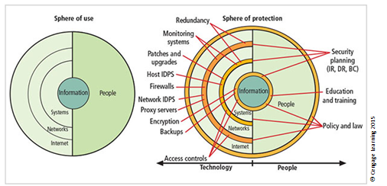
Figure 4-8 Spheres of security
Notes:
Figure 6-16, showing the sphere of security, is the foundation of the security framework.
Generally speaking, the sphere of security represents the fact that information is under attack from a variety of sources. The sphere of use, at the left of the figure, illustrates the ways in which people can directly access information; for example, people read hard copies of documents; they also access information through systems, such as the electronic storage of information.
Information, as the most important asset to security, is illustrated at the core of the sphere. Information is always at risk from attacks through the people and computer systems that have direct access to the information. Networks and the Internet represent indirect threats, as exemplified by the fact that a person attempting to access information from the Internet must first go through the local networks and then access systems that contain the information. The sphere of protection, at the right of the figure, illustrates that between each layer of the sphere of use there must exist a layer of protection to prevent access to the inner layer from the outer layer. Each shaded band is a layer of protection and control. For example, the layer labeled “policy education and training” is located between people and the information.
Controls are also implemented between systems and the information, between networks and the computer systems, and between the Internet and internal networks. This reinforces the concept of defense in depth.
As illustrated in the sphere of protection portion of Figure 6-16, a variety of controls can be used to protect the information. The list in the figure is not intended to be comprehensive but illustrates individual safeguards that protect the various systems that are located closer to the center of the sphere. However, as people can directly access each ring as well as the information at the core of the model, people require unique approaches to security.
In fact, the resource of people must become a layer of security, a human firewall that protects the information from unauthorized access and use. The members of the organization must become a safeguard, which is effectively trained, implemented, and maintained, or else they, too, become a threat to the information.

Slide 52
Continuity Strategies (2 of 2)
Before planning can actually begin, a team has to start the process
Champion: high-level manager to support, promote, and endorse findings of the project
Project manager: leads project and ensures sound project planning process is used, a complete and useful project plan is developed, and project resources are prudently managed
Team members: should be managers, or their representatives, from various communities of interest: business, IT, and information security
Notes:
Contingency Planning Team
Before any planning can begin, a team has to plan the effort and prepare the resulting documents
Champion - A high-level manager to support, promote, and endorse the findings of the project
Project Manager - Leads the project and makes sure a sound project planning process is used, a complete and useful project plan is developed, and project resources are prudently managed
Team Members - Should be the managers or their representatives from the various communities of interest: business, IT, and information security

Slide 53
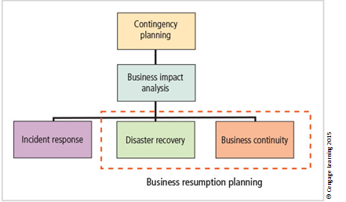
Figure 4-12 Components of contingency planning

Slide 54
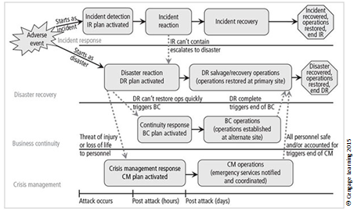
Figure 4-13 Contingency planning timeline

Slide 55
Contingency Planning (CP) Process
Includes the following steps:
Develop CP policy statement
Conduct business impact analysis
Identify preventive controls
Create contingency strategies
Develop contingency plan
Ensure plan testing, training, and exercises
Ensure plan maintenance
Notes:
Contingency Planning Process
Includes following steps:
Develop CP policy statement
Conduct business impact analysis
Identify preventive controls
Create contingency strategies
Develop contingency plan
Ensure plan testing, training, and exercises
Ensure plan maintenance

Slide 56
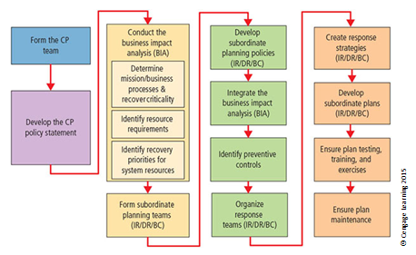
Figure 4-14 Major steps in contingency planning

Slide 57
The CP Policy
Should contain the following sections:
Introductory statement of philosophical perspective
Statement of scope/purpose
Call for periodic risk assessment/BIA
Specification of CP’s major components
Call for/guidance in the selection of recovery options
Requirement to test the various plans regularly
Identification of key regulations and standards
Identification of key people responsible for CP operations
Challenge to the organization members for support
Administrative information
Notes:
CP Policy
Should contain following sections:
Introductory statement of philosophical perspective
Statement of scope/purpose
Call for periodic risk assessment/BIA
Specification of CP’s major components
Call for/guidance in selection of recover options
Requirement to test various plans regularly
Identification of key regulations and standards
Identification of key people responsible for CP operations
Challenge to organization members for support
Administrative information

Slide 58
Business Impact Analysis (BIA)
Investigation and assessment of various adverse events that can affect organization
Assumes security controls have been bypassed, have failed, or have proven ineffective, and the attack has succeeded
Organization should consider scope, plan, balance, knowledge of objectives, and follow-ups
Three stages:
Determine mission/business processes and recovery criticality
Identify recovery priorities for system resources
Identify resource requirements

Slide 59
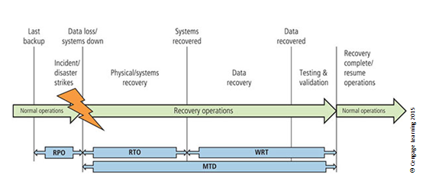
Figure 4-15 RPO, RTO, WRT, and MTD
Source: http://networksandservers.blogspot.com/2011/02/high-availability-terminology-ii.html.

Slide 60
Incident Response Planning (1 of 8)
Incident response planning includes identification of, classification of, and response to an incident.
Attacks classified as incidents if they:
Are directed against information assets
Have a realistic chance of success
Could threaten confidentiality, integrity, or availability of information resources
Incident response is more reactive than proactive, with the exception of planning that must occur to prepare IR teams to be ready to react to an incident.
Notes:
Incident Response Planning
Incident response planning covers the identification of, classification of, and response to an incident.
The IRP is made up of activities that are to be performed when an incident has been identified.
An incident is an attack against an information asset that poses a clear threat to the confidentiality, integrity, or availability of information resources.
Attacks are only classified as incidents if they have the following characteristics:
Are directed against information assets
Have a realistic chance of success
Could threaten the confidentiality, integrity, or availability of information resources.
Incident response (IR) is the set of activities taken to plan for, detect, and correct the impact of an incident on information resources.
IR is more reactive than proactive, with the exception of the planning that must occur to prepare the IR teams to be ready to react to an incident.
Planning for an incident requires a detailed understanding of the scenarios developed for the BIA.

Slide 61
Incident Response Planning (2 of 8)
Incident response policy identifies the following key components:
Statement of management commitment
Purpose/objectives of policy
Scope of policy
Definition of InfoSec incidents and related terms
Organizational structure
Prioritization or severity ratings of incidents
Performance measures
Reporting and contact forms
Notes:
IR Planning
Incident response policy identifies following key components
Statement of management commitment
Purpose/objectives of policy
Scope of policy
Definition of InfoSec incidents and related terms
Organizational structure
Prioritization or severity ratings of incidents
Performance measures
Reporting and contact forms

Slide 62
Incident Response Planning (3 of 8)
Incident Planning
Predefined responses enable the organization to react quickly and effectively to the detected incident if:
The organization has an IR team
The organization can detect the incident
IR team consists of individuals needed to handle systems as incident takes place
Incident response plan
Format and content
Storage
Testing
Notes:
Incident Response Planning
Incident Planning
Predefined responses enable organization to react quickly and effectively to detected incident if:
Organization has IR team
Organization can detect incident
IR team consists of individuals needed to handle systems as incident takes place
Incident response plan
Format and content
Storage
Testing

Slide 63
Incident Response Planning (4 of 8)
Incident detection
Most common occurrence is complaint about technology support, often delivered to help desk.
Careful training is needed to quickly identify and classify an incident.
Once incident is properly identified, the organization can respond.
Incident indicators vary.
Notes:
Incident Response Planning
Incident detection
Most common occurrence is complaint about technology support, often delivered to help desk
Careful training needed to quickly identify and classify an incident
Once incident is properly identified, organization can respond
Incident indicators vary

Slide 64
Incident Response Planning (5 of 8)
Incident reaction
Consists of actions that guide the organization to stop incident, mitigate its impact, and provide information for recovery
Actions that must occur quickly:
Notification of key personnel
Documentation of the incident
Incident containment strategies
Containment of incident’s scope or impact is first priority; must then determine which information systems are affected
Notes:
Incident Response Planning
Incident reaction
Consists of actions that guide organization to stop incident, mitigate its impact, and provide information for recovery
Actions that must occur quickly:
Notification of key personnel
Documentation of incident
Incident containment strategies
Containment of incident’s scope or impact first priority; must then determine which information systems affected
Organization can stop incident and attempt to recover control through a number or strategies

Slide 65
Incident Response Planning (6 of 8)
Organization can stop incident and attempt to recover control through a number or strategies
Incident recovery
Once incident has been contained and control of systems regained, the next stage is recovery.
The first task is to identify human resources needed and launch them into action.
Full extent of the damage must be assessed.
Notes:
Incident Recovery
Once the incident has been contained and control of the systems regained, the next stage is recovery.
As with reaction to the incident, the first task is to identify the human resources needed for the recovery and launch them into action.
The full extent of the damage must be assessed.
The process of computer forensics entails determining how the incident occurred and what happened.
The organization repairs vulnerabilities, addresses any shortcomings in safeguards, and restores the data and services of the systems.

Slide 66
Incident Response Planning (7 of 8)
Organization repairs vulnerabilities, addresses any shortcomings in safeguards, and restores data and services of the systems.
Damage assessment
Several sources of information on damage can be used, including system logs, intrusion detection logs, configuration logs and documents, documentation from incident response, and results of detailed assessment of systems and data storage.
Computer evidence must be carefully collected, documented, and maintained to be usable in formal or informal proceedings.
Notes:
Damage Assessment
Damage assessment
Several sources of information on damage, including system logs; intrusion detection logs; configuration logs and documents; documentation from incident response; and results of detailed assessment of systems and data storage
Computer evidence must be carefully collected, documented, and maintained to be usable in formal or informal proceedings
Individuals who assess damage need special training

Slide 67
Incident Response Planning (8 of 8)
Individuals who assess damage need special training.
Automated response
New systems can respond to incident threat autonomously.
Downsides of current automated response systems may outweigh benefits.
Legal liabilities of a counterattack
Ethical issues
Notes:
Automated Response
While traditional systems were configured to detect incidences and then notify the human administrator, new systems can respond to the incident threat autonomously.
These systems, referred to as trap and trace, use a combination of resources to detect an intrusion and then trace incidents back to their sources.
Unfortunately, some less scrupulous administrators might even be tempted to back hack or hack into a hacker’s system to find out as much as possible about the hacker.
The problem is that the hacker may actually move into and out of a number of organizations’ systems, and by tracking the hacker, administrators may wander through other organizations’ systems.
The trap portion frequently involves the use of honey pots or honey nets.
Honey pots are computer servers configured to resemble production systems. If a hacker stumbles into the system, alarms are set off and the administrator is notified.
Honey nets consist of networks or subnets of systems that operate similarly.
Enticement is the process of attracting attention to a system by placing tantalizing bits of information in key locations.
Entrapment is the action of luring an individual into committing a crime to get a conviction.
Enticement is legal and ethical, while entrapment is not.

Slide 68
Disaster Recovery Planning
Disaster recovery planning (DRP) is preparation for and recovery from a disaster.
The contingency planning team must decide which actions constitute disasters and which constitute incidents.
When situations are classified as disasters, plans change as to how to respond; take action to secure most valuable assets to preserve value for the longer term.
DRP strives to reestablish operations at the primary site.
Notes:
Disaster Recovery Planning
Disaster recovery planning (DRP) is planning the preparation for and recovery from a disaster
The contingency planning team must decide which actions constitute disasters and which constitute incidents
When situations classified as disasters, plans change as to how to respond; take action to secure most valuable assets to preserve value for the longer term
DRP strives to reestablish operations at the primary site

Slide 69
Business Continuity Planning (1 of 3)
BCP prepares the organization to reestablish or relocate critical business operations during a disaster that affects operations at the primary site.
If disaster has rendered the current location unusable, there must be a plan to allow business to continue functioning.
Development of BCP is somewhat simpler than IRP or DRP.
It consists primarily of selecting a continuity strategy and integrating off-site data storage and recovery functions into this strategy.
Notes:
Business Continuity Planning
Prepares organization to reestablish or relocate critical business operations during a disaster that affects operations at the primary site
If disaster has rendered current location unusable, there must be a plan to allow business to continue functioning
Development of BCP is somewhat simpler than IRP or DRP
Consists primarily of selecting a continuity strategy and integrating off-site data storage and recovery functions into this strategy

Slide 70
Business Continuity Planning (2 of 3)
Continuity strategies
There are a number of strategies for planning for business continuity.
Determining factor in selecting between options is usually cost.
In general, there are three exclusive options: hot sites, warm sites, and cold sites.
There are three shared functions: time-share, service bureaus, and mutual agreements.
Notes:
Continuity Strategies
Continuity strategies
There are a number of strategies for planning for business continuity
Determining factor in selecting between options is usually cost
In general there are three exclusive options: hot sites, warm sites, and cold sites
Three shared functions: time-share, service bureaus, and mutual agreements

Slide 71
Business Continuity Planning (3 of 3)
Off-site disaster data storage
To get sites up and running quickly, an organization must have the ability to move data into new site’s systems.
Options for getting operations up and running include:
Electronic vaulting
Remote journaling
Database shadowing
Notes:
Off-Site Disaster Data Storage
Off-Site disaster data storage
To get sites up and running quickly, an organization must have the ability to move data into new site’s systems
Options for getting operations up and running include:
Electronic vaulting
Remote journaling
Database shadowing

Slide 72
Crisis Management (1 of 3)
Actions taken in response to an emergency should minimize injury/loss of life, preserve organization’s image/market share, and complement disaster recovery/business continuity processes.
What may truly distinguish an incident from a disaster are the actions of the response teams.
Disaster recovery personnel must know their roles without any supporting documentation.
Preparation
Training
Rehearsal
Know what it is
Notes:
Crisis Management
Actions taken in response to an emergency to minimize injury/loss of life, preserve organization’s image/market share, and complement disaster recovery/business continuity processes
What may truly distinguish an incident from a disaster are the actions of the response teams
Disaster recovery personnel must know their roles without any supporting documentation
Preparation
Training
Rehearsal

Slide 73
Crisis Management (2 of 3)
Crisis management team is responsible for managing the event from an enterprise perspective and covers:
Supporting personnel and families during crisis
Determining impact on normal business operations and, if necessary, making disaster declaration
Keeping the public informed
Communicating with major customers, suppliers, partners, regulatory agencies, industry organizations, the media, and other interested parties
Notes:
Crisis Management
Crisis management team is responsible for managing event from an enterprise perspective and covers:
Supporting personnel and families during crisis
Determining impact on normal business operations and, if necessary, making disaster declaration
Keeping the public informed
Communicating with major customers, suppliers, partners, regulatory agencies, industry organizations, the media, and other interested parties

Slide 74
Crisis Management (3 of 3)
Key areas of crisis management also include:
Verifying personnel head count
Checking alert roster
Checking emergency information cards
Notes:
Crisis Managment
Key areas of crisis management also include
Verifying personnel head count
Checking alert roster
Checking emergency information cards

Slide 75
The Consolidated Contingency Plan
Single document set approach combines all aspects of contingency policy and plan, incorporating IR, DR, and BC plans.
Often created and stored electronically, it should be easily accessible by employees in time of need.
Small- and medium-sized organizations may also store hard copies of the document.
Notes:
Consolidated Contingency Plan
Single document set approach combines all aspects of contingency policy and plan, incorporating IR, DR, and BC plans
Often created and stored electronically, should be easily accessible by employees in time of need
Small and medium-sized organizations may also store hard copies of document

Slide 76
Law Enforcement Involvement
When incident at hand constitutes a violation of law, the organization may determine involving law enforcement is necessary.
Questions:
When should law enforcement get involved?
What level of law enforcement agency should be involved (local, state, federal)?
What happens when law enforcement agency is involved?
Some questions are best answered by the legal department.
Notes:
Law Enforcement Involvement
There may come a time when it has been determined that the incident at hand exceeds the violation of policy and constitutes a violation of law.
The organization may determine that involving law enforcement is necessary.
There are several questions that must then be answered.
When should the organization get law enforcement involved?
What level of law enforcement agency should be involved: local, state, or federal?
What will happen when the law enforcement agency is involved?
Some of these questions are best answered by the organization’s legal department.

Slide 77
Benefits and Drawbacks of Law Enforcement Involvement (1 of 2)
Advantages of involving law enforcement agencies:
Agencies may be better equipped at processing evidence.
Organization may be less effective in extracting the necessary information to legally convict a suspected criminal.
Law enforcement agencies are prepared to handle any necessary warrants and subpoenas.
Law enforcement is skilled at obtaining witness statements and other information collection.
Notes:
Benefits of Law Enforcement Involvement
Involving law enforcement agencies has advantages:
Agencies may be better equipped at processing evidence
Organization may be less effective in extracting necessary information to legally convict suspected criminal
Law enforcement agencies are prepared to handle any necessary warrants and subpoenas
Law enforcement is skilled at obtaining witness statements and other information collection

Slide 78
Benefits and Drawbacks of Law Enforcement Involvement (2 of 2)
Disadvantages of involving law enforcement agencies:
Once a law enforcement agency takes over the case, the organization cannot control the chain of events.
The organization may not hear about the case for weeks or months.
Equipment vital to the organization’s business may be tagged as evidence.
If the organization detects a criminal act, it is legally obligated to involve appropriate law enforcement officials.
Notes:
Drawbacks to Law Enforcement Involvement
Involving law enforcement agencies has disadvantages:
Once a law enforcement agency takes over case, organization cannot control chain of events
Organization may not hear about case for weeks or months
Equipment vital to the organization’s business may be tagged as evidence
If organization detects a criminal act, it is legally obligated to involve appropriate law enforcement officials

Slide 79
Summary (1 of 2)
Management has an essential role in the development, maintenance, and enforcement of information security policy, standards, practices, procedures, and guidelines.
Information security blueprint is planning the document that is the basis for design, selection, and implementation of all security policies, education and training programs; and technological controls.

Slide 80
Summary (2 of 2)
Information security education, training, and awareness (SETA) is a control measure that reduces accidental security breaches and increases organizational resistance to many other forms of attack.
Contingency planning (CP) is made up of three components: incident response planning (IRP), disaster recovery planning (DRP), and business continuity planning (BCP).

